Slide 1
The Value of Flexibility*
EPEX SPOT, Dr. Philippe Vassilopoulos
02/12/2016
*Based on “The Value of Flexibility in Power Markets” by Stephane GOUTTE and Philippe VASSILOPOULOS, November 14, 2016 (submitted to the Energy Journal)

Slide 2
Ways of trading power on European Wholesale markets
Power commercialization
Wholesale Market
System Services
Organized Market: Exchange
Over-The-Counter (OTC)
Derivatives Market
Futures/Options
Mainly financial fulfillment
Spot Market
- Physical fulfillment
Derivatives Market
Forwards/Options/
Structured Products
Financial and physical fulfillment
Balancing
Other system services (e.g. primary reserves, restoration reserves)
Day-Ahead market
- Auction
Intraday Market Continuous trading
Spot Market

Slide 3
The wholesale energy trading process
Hourly Day-Ahead
auction
coupled EU-wide
EPEX SPOT
15-Minute Auction (DE)
EPEX SPOT continuous
15-Min Intraday
EPEX SPOT continuous
hourly Intraday
TRADING
PROCESS
12:00
14:30
15:00
16:00
Start of
Intraday Nominations
30 Min
before
delivery
AIM
Hourly
optimization
15-min
optimization
Continuous
Hourly & quarterly optimiziation

Slide 4
RES development has boosted need to balance on the Intraday market
Solar and Wind Installed Capacity in Germany
Source: Statkraft

Slide 5
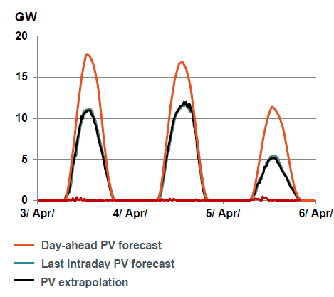
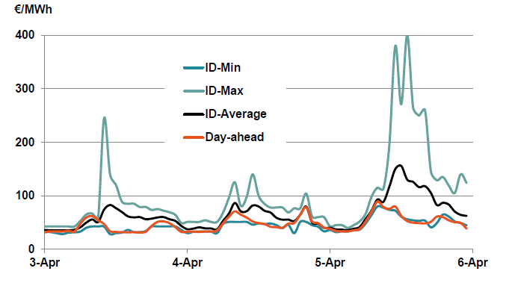
Balancing needs exacerbated by forecast errors
  Generation ramps handled with quarters
  Forecast deviations : Wind/solar forecasts can vary significantly from Day-ahead forecast to last Intraday Forecast
Generation Ramps
Forecast Deviations
Generation
15mn products profile
Day-ahead forecast
Intraday forecast
Real Feed-in
Hourly products
profile
Day-ahead PV forecast inaccuracy and Intraday price impact
Source: 50 Hertz, EPEX SPOT

Slide 6
The German IDM liquidity has been boosted by iRES penetration

Slide 7
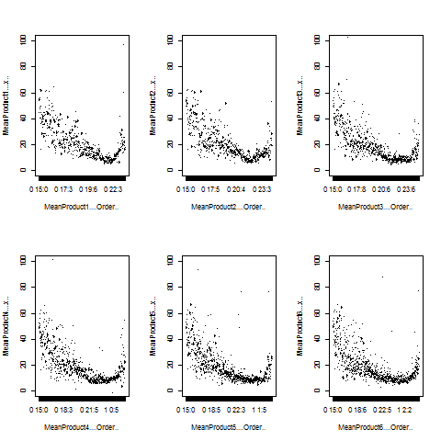
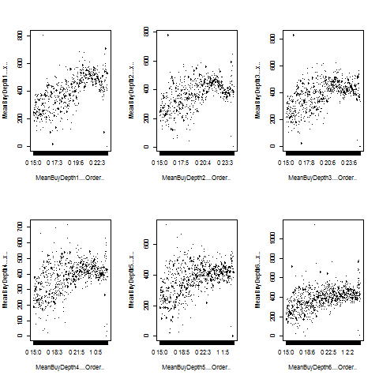
Bid/Ask spreads and market depth for several individual continuous hourly products
Bid/Ask spread during the session for individual products
Market depth during the session for individual products

Slide 8
The German IDM Prices can vary significantly during the trading session
Evolution of hourly wholesale prices on the Day-ahead and Intraday market in Germany from 01/2013 to 06/2015

Slide 9
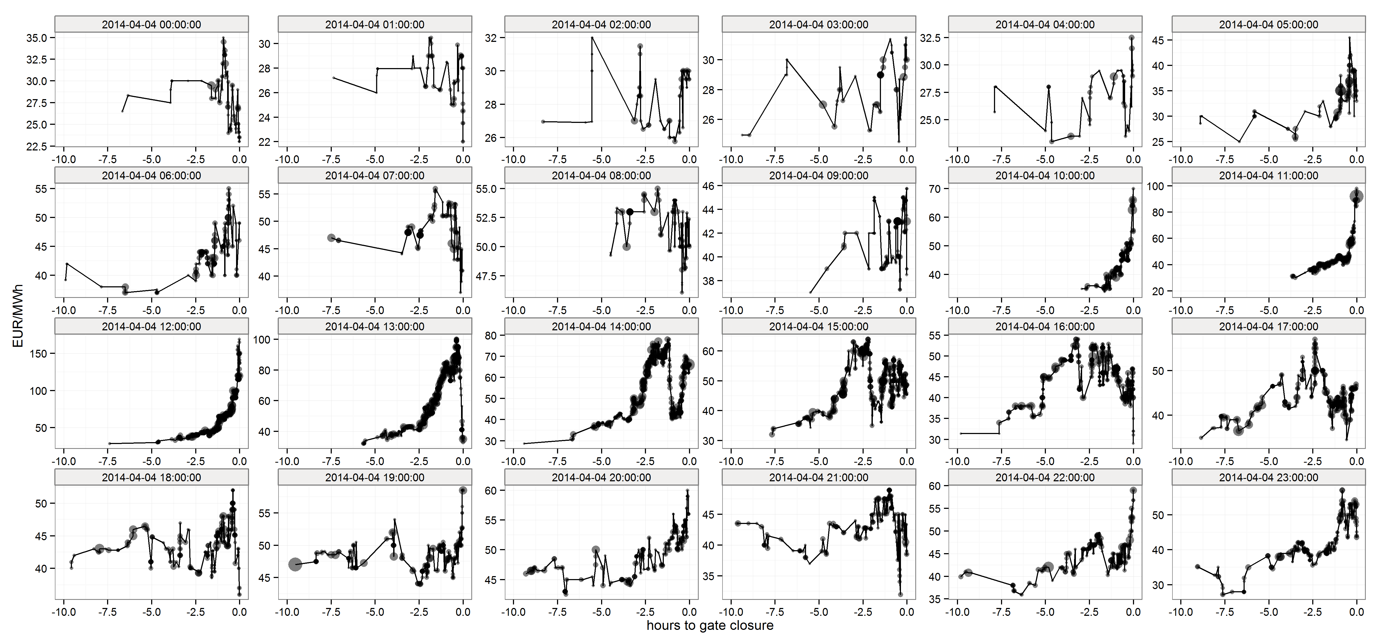
Some Intraday Price Developments…
Source: EPEX SPOT

Slide 10
What is flexibility? Is there a value for flexibility on the Intraday?
System
level
« Ability of the system to accomodate increasing levels of uncertainty while maintaining satisfactory levels of performance »
« Ability of a ressource to start-up quickly and adjust load output to changing market conditions»
Ressource level
Source: EPEX SPOT

Slide 11
What are the theoretical revenues for the perfect CCGT offered on the day-ahead?
Net revenues for a 55% efficient CCGT at the Day-ahead prices in France, Germany
  Source: EPEX SPOT, EEX, ICE

Slide 12
The share of revenues from hourly Intraday compared to day-ahead
DAM/IDM theoretical net revenues for a 1MW perfect CCGT
Source: EPEX SPOT, EEX

Slide 13
A flexible plant can increase revenues significantly on the quarterly market
IDM theoretical net revenues for a 1MW CCGT with quarters/
hours
€/MW-yr | Continuous Hr (High) | Continuous Qr (High) | Continuous Qr (WAP) | Continuous Qr (Low)
2013 | 59 729,39 | 95 501,44 | 33 407,95 | 6 191,27
2014 | 49 436,61 | 98 187,12 | 30 737,11 | 5 203,61
2015 | 17 833,67 | 33 682,18 | 8 162,30 | 1 212,21
On/Off decisions of the plant at the quarterly level
Flexible plants benefit from higher price volatility at quarterly level
Revenues almost double with quarters
Perfect flexibility at quarterly level very challenging…
Source: EPEX SPOT, EEX

Slide 14
An unflexible plant would not see benefits in trading quarterly contracts
€/MW-Yr | Intraday quarterly (High) | Intraday quarterly (Min up time 2hrs) | Intraday quarterly (Min up time 3hrs) | Intraday quarterly (Min up time 8hrs) | Intraday hourly (High)
2013 | 95 501 | 89 553 | 70 757 | 54 242 | 59 729
2014 | 98 187, | 94 328 | 77 506, | 64 046 | 49 436
2015 | 33 682, | 32 517 | 29 318, | 24 295 | 17 833
Source: EPEX SPOT, EEX

Slide 15
Revenue volatility during the trading session can be high on the continuous Intraday
€/MW-Yr | Intraday hourly High | Intraday hourly Weighted average | Intraday hourly Low | DAM revenues
2013 | 59 729,4 | 19 629,1 | 4 488,5 | 15 282,2
2014 | 49 436,6 | 16 812,9 | 3 921,8 | 13 590,2
2015 | 17 833,7 | 4 732,0 | 1 247,0 | 4 367,5
On the Continuous market, revenues depend a lot on the trading skils/risk profile/luck…
A trader that gets the high prices can make three times more revenue than a trader that captures the average price
In reality, as pay-as-bid only a very small fraction of the market captures the high price
Source: EPEX SPOT, EEX

Slide 16
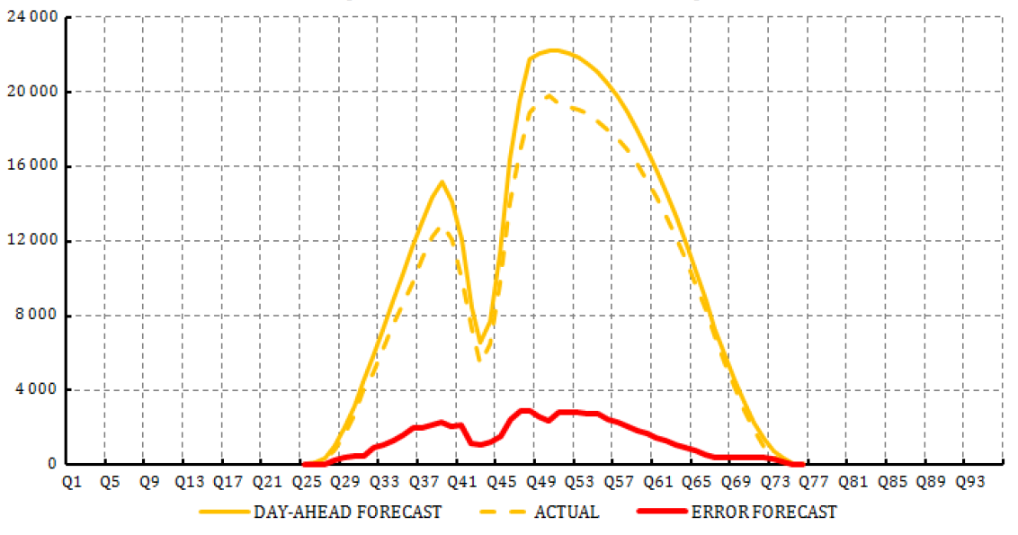
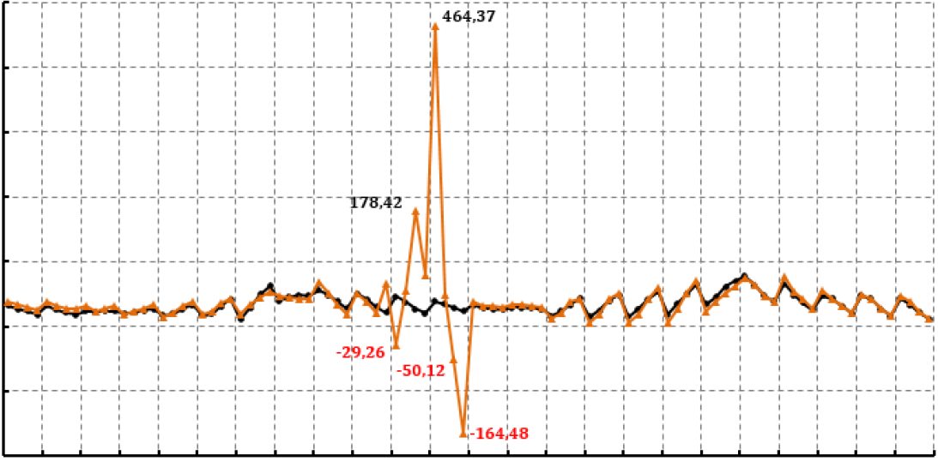
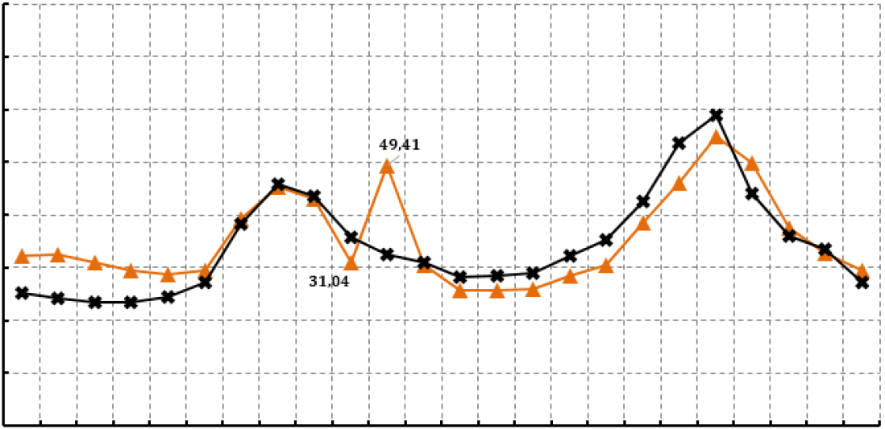
An example of a situation that required flexibility, the solar eclipse…
Solar forecast
Intraday Prices
500
€/MWh
464,37
400
300
200
178,42
100
Day-Ahead Prices
0
-29,26
60
€/MWh
49.41
-100
-50,12
50
-164,48
40
-200
Q1
Q9
Q17
Q25
Q33
Q41
Q49
Q65
Q73
Q81
Q89
30
Q57
31.04
20
10
0
H1
H5
H10
H15
H20
H24
Source: EPEX SPOT, TSOs

Slide 17
Flexibility values: the Immediacy and the flexibility
1. The "immediacy" value as we are approaching real-time and the urgency of the delivery increases. This value is revealed during the continuous intraday process
and is highly linked to the forecast error risk.
2. The “flexibility” as a resource can capture variations of shorter granularity. This is more related to the technical characteristics of the asset and its optimization and can be priced already at the day-ahead stage through auctions for 15/30mn products and potentially 5mn at a later stage.
We use a Brownian motion with jumps to model the “flexibility” value (revenues that stem from 15mn and 60mn auctions in DAM)

Slide 18
Numerical results of the «Flexibility» value
Day-ahead hourly auction and the 15mn Call-Auction price distributions for different maturities.
Hourly payoff for variations of the volatility and jump parameters at default time
Quarterly payoff for variations of the volatility and jump parameters at default time

